Slide 1
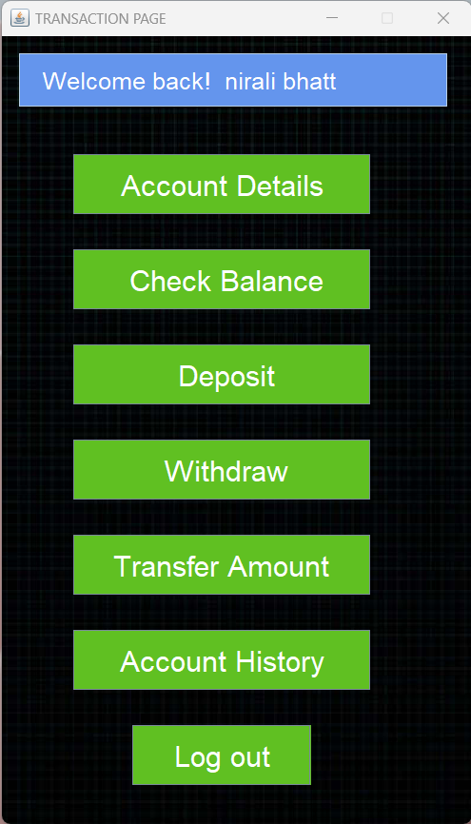

Vishnu Waman Thakur Charitable Trust’s
VIVA INSTITUTE OF TECHNOLOGY
Shirgaon, Virar (East)
CashCraft: Mastering Your Financial Journey
NAME: Ms. Durga Adhikari Chhetri
ROLL NO: 1
CLASS: FYMCA
SEMESTER: I
GUIDED BY: Prof. Shreya Bhamare

Slide 2
index
Introduction
Objectives
Scope
Existing System
Disadvantages Of Existing System
Proposed System
S/W Development Model
Introduction To SRS
Technological Requirements
Modules Of The Project
Object Oriented Analysis & Design Diagram
I/O Screen Layout
Testing
Conclusion
Future Enhancements
References

Slide 3
introduction
The CashCraft project revolutionizes the realm of financial transactions by introducing a unique fintech application.
CashCraft is a financial technology application designed to facilitate money transfers between users.
It eliminates the dependency on traditional banking by allowing individuals to create accounts and perform transactions without the need for a bank account.
Inspired by the ease of railway card systems, the project introduces a hybrid model that combines digital convenience with the familiarity of physical deposit locations.

Slide 4
Objectives
Accessibility
Innovation
User friendly
Addressing the exclusion of individuals without traditional bank accounts
Introducing a hybrid model inspired by familiar systems
Provide user-friendly GUI without tedious processes
Simplicity
Financial Inclusion
Simplifying the process of money transfers and account management
Making it accessible to a wider audience

Slide 5
Scope of the project
Account Creation
Balance & Transaction History
Money Transfer
Deposit & Withdrawal
Flexibility & control
Initial it just for demo to show deposits and withdrawal on account but will be available in future post-admin login.
User can edit the information or
delete account. User have complete control over it.
Users can create accounts by providing basic details, eliminating the need for a traditional bank account.
Facilitating seamless money transfers between users within the
application.
Enabling users to monitor account balance and
transaction history.

Slide 6

SYSTEM STUDY AND PLANNING

Slide 7
Existing System
Bank-Centric Transactions
Traditional Banking Infrastructure
Account Dependency
Bank Account Dependency
Digital Payment Platforms
Limited Accessibility

Slide 8
Disadvantages of Existing System
Exclusion of Unbanked Individuals.
Complex Banking and transaction Procedures.
Geographical Limitations.
Limited Innovation and Flexibility.

Slide 9
Proposed System
Bankless Transactions:
Allows users to create accounts and transfer money without requiring traditional bank accounts.
Simplifies the process, making it more accessible to a wider audience.
Accessibility and Convenience:
Provides a straightforward process for money transfers, creating a user-friendly experience.
Users can keep track of their account history and have full control over their account for editing and Deletion.

Slide 10
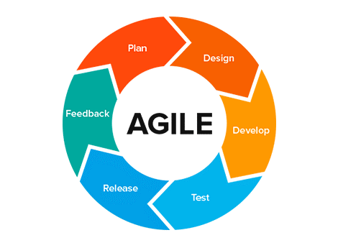
S/W development Model
The Agile model suits the CashCraft project by enabling adaptability to changes in financial service requirements, focusing on user needs, and facilitating continuous improvements based on feedback.
Agile Development Model

Slide 11
Introduction to SRS
Non-functional Requirements:
Responsive performance handling multiple requests.
Reliable system uptime and regular data backups.
Functional Requirements:
User authentication for secure logins.
Account management to view balances and transactions.
Secure money transfer between registered users.
Constraints:
Initial deposits and withdrawal limited to physical centers.
Deposit and Withdrawals accessible in future post-admin login .

Slide 12
Technological Requirements
Software/tools to be Used
Programming Language: Java.
IDE (Integrated Development Environment: Eclipse.
Database system: MySQL.
Graphical tool to manage Database : MySQL Workbench.
Java Libraries/Frameworks(GUI): AWT and Swing.
Hardware to be Used
Computing Devices: Desktops or Laptops.
Memory and Storage: Adequate RAM and storage.

Slide 13
Modules of the project
Account Creation
Account History
Login
Transaction
Transfer Amount
CashCraft
Account Details
Withdraw
Deposit
Check Balance

Slide 14
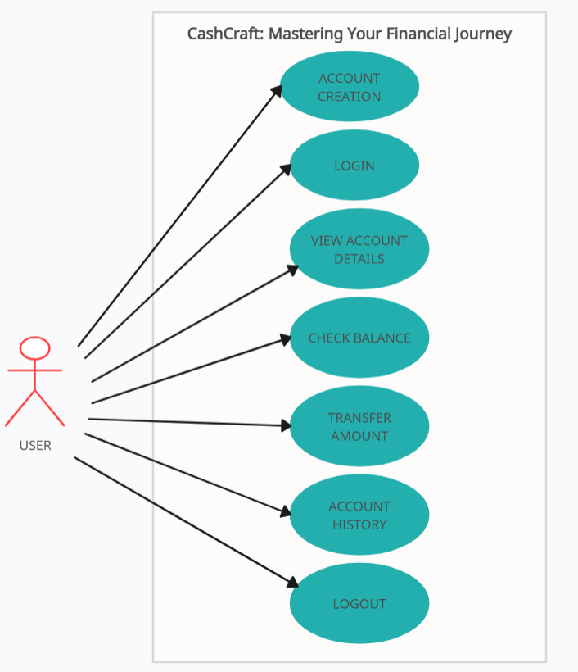
Object Oriented Analysis & Design Diagram
Use Case Diagram

Slide 15
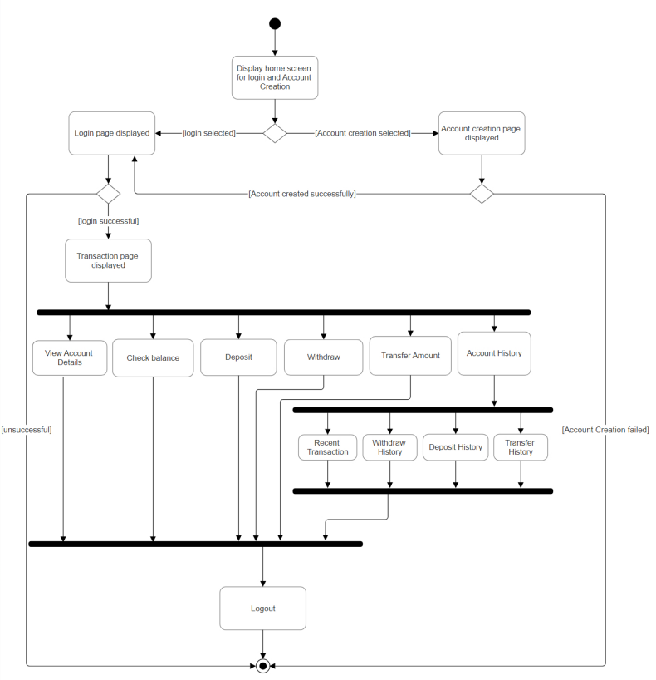
Activity Diagram

Slide 16
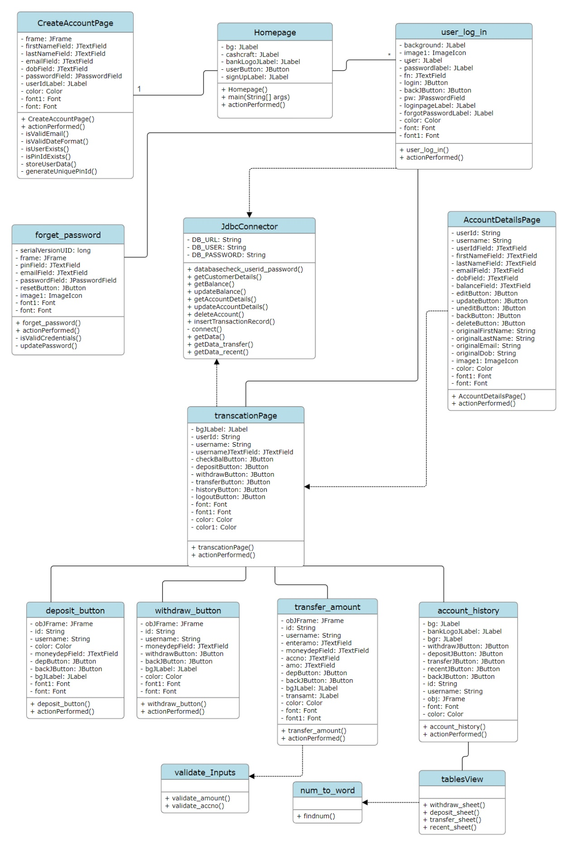
Class Diagram

Slide 17
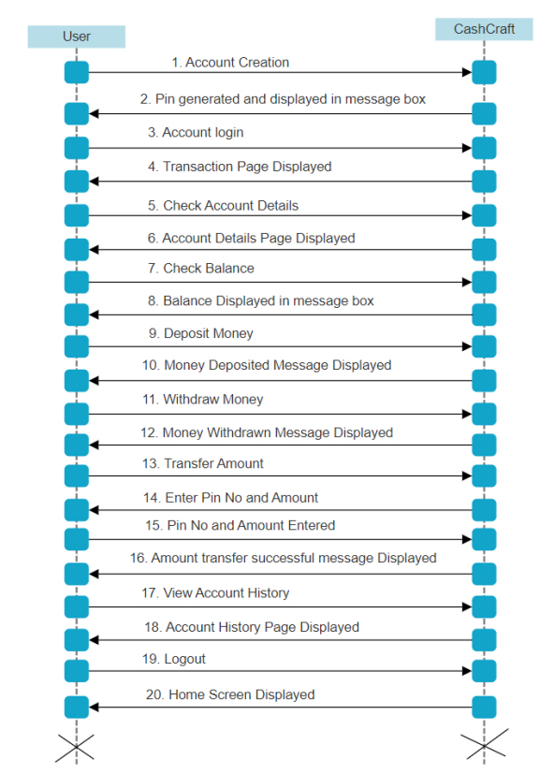
Sequence Diagram

Slide 18
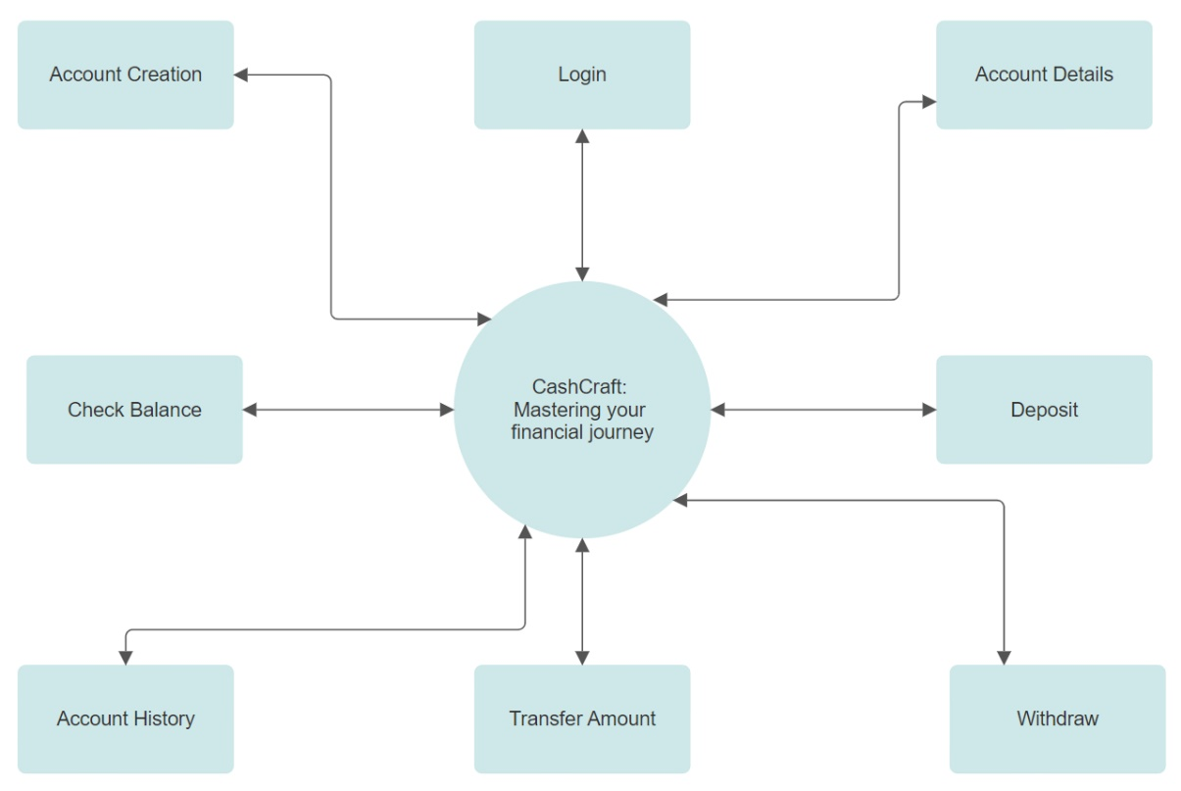
DFD Level 0 / Context Diagram

Slide 19
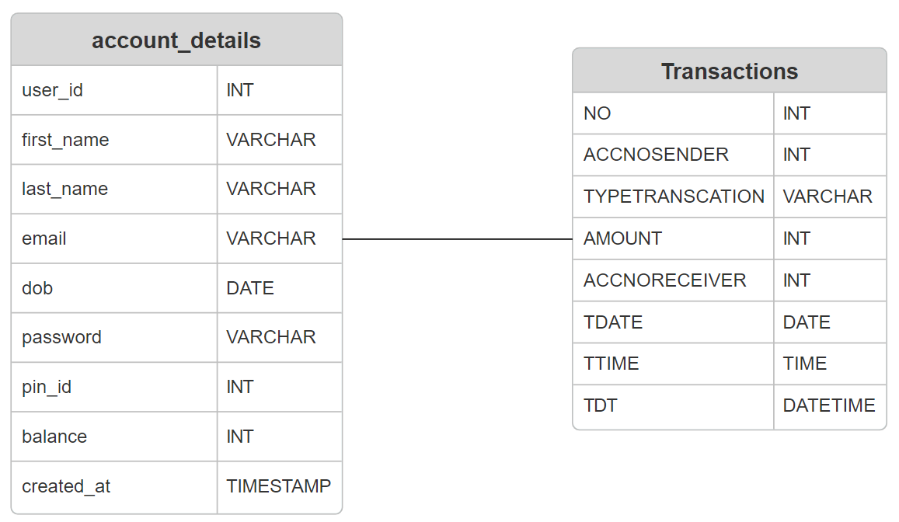
Database Table

Slide 20
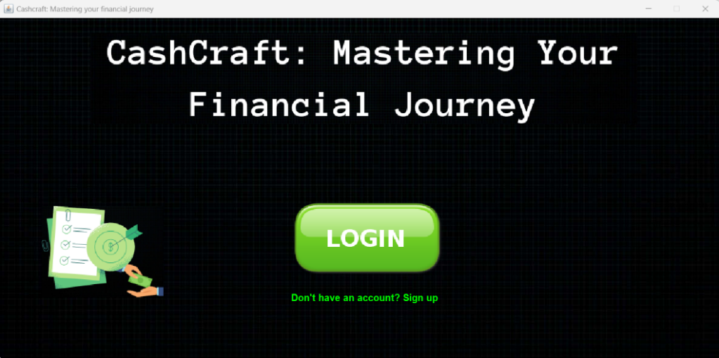
I/O Screen Layout
Homepage: It’s the main entry point of the application. This is the first page that displays when the application is opened/started.

Slide 21
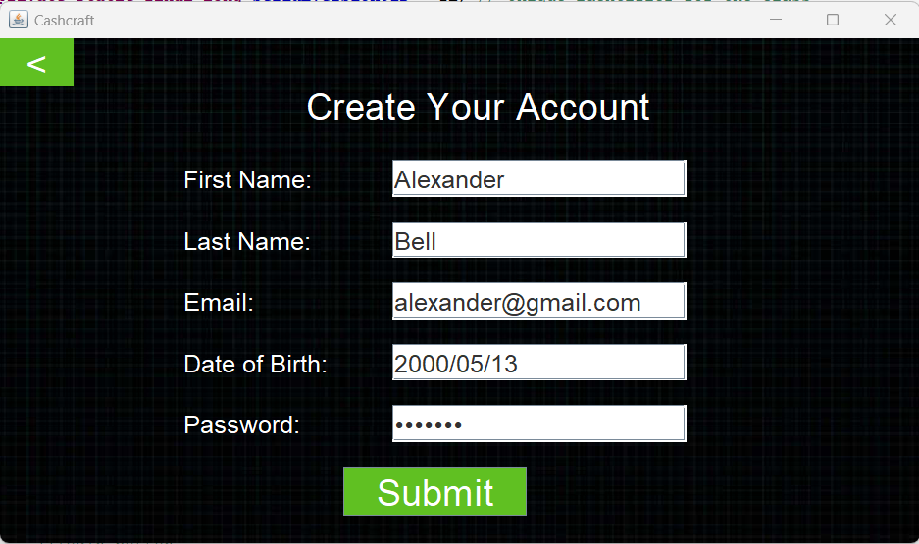
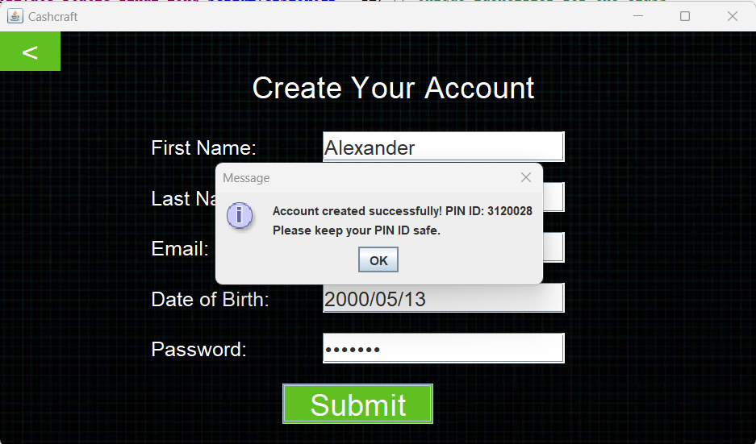
Account Creation: User needs to create an account for the use of the application.
Once the account is created automatically 7 number unique Pin is generated for the user which the user needs to remember or write it down safely.

Slide 22
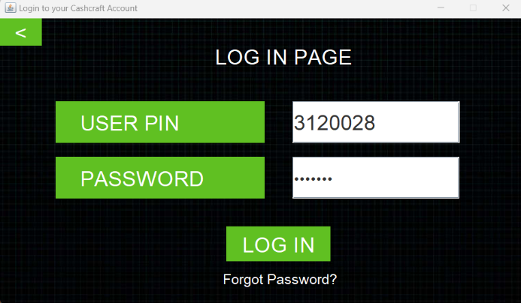
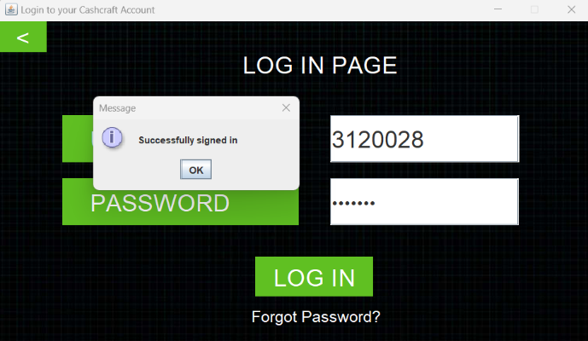
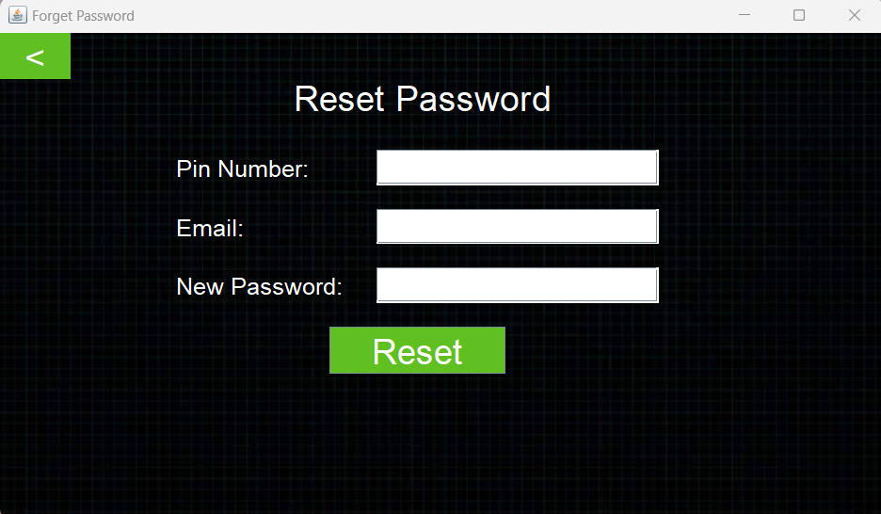
Login Page: User needs to login to the account with generated Pin provided during account creation and password for authentication.
Reset Password Page: User can reset the password if they forget by clicking on forgot Password? in login page

Slide 23
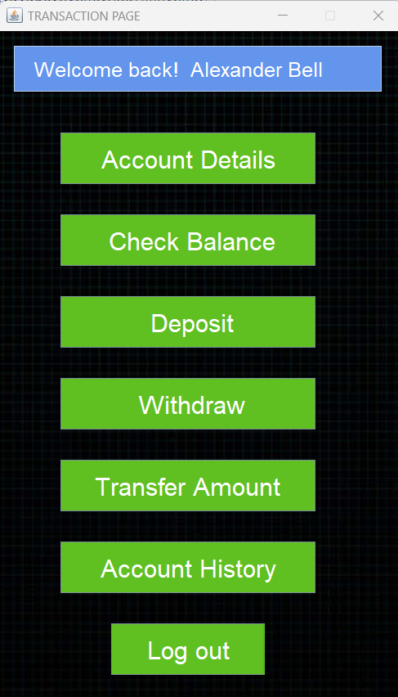
Transaction Page: Once the user successfully Log In, the main page is displayed from where user can perform all activities listed in it. For now Deposit and withdraw are demo to show its working and will be available in future post-admin login setup.

Slide 24
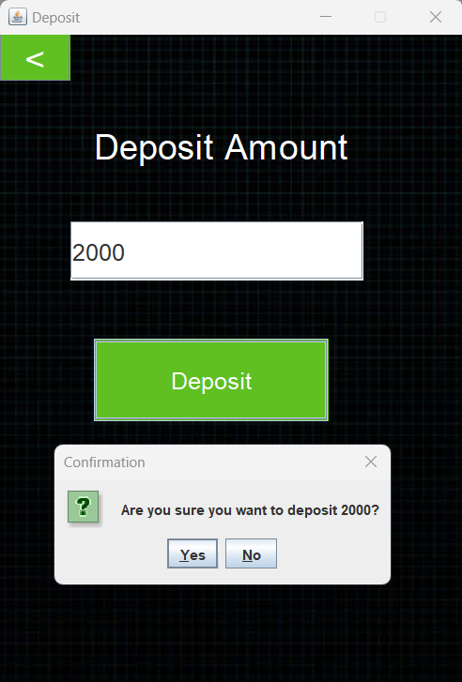
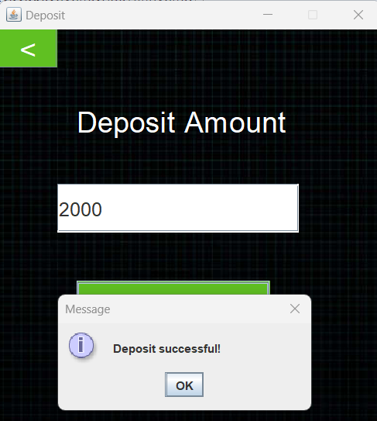
Deposit Page: The amount is deposited in user account. It’s a Placeholder for future integration with physical centers post-admin login setup and only admin of fintech solution providing CashCraft services will be able to perform it.

Slide 25
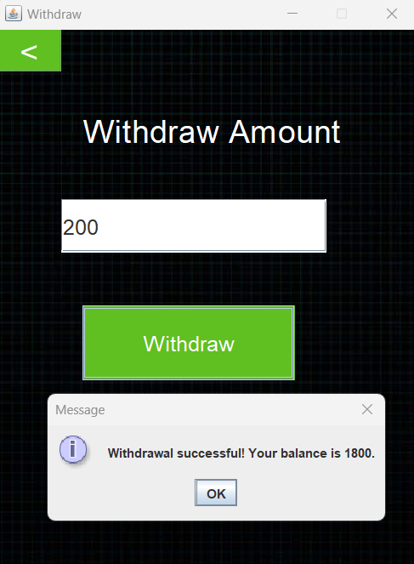
Withdraw Page: The amount is withdrawn from user’s account. It’s a Placeholder for future integration with physical centers post-admin login setup and only admin of fintech solution providing CashCraft services will be able to perform it and provide cash to user.

Slide 26
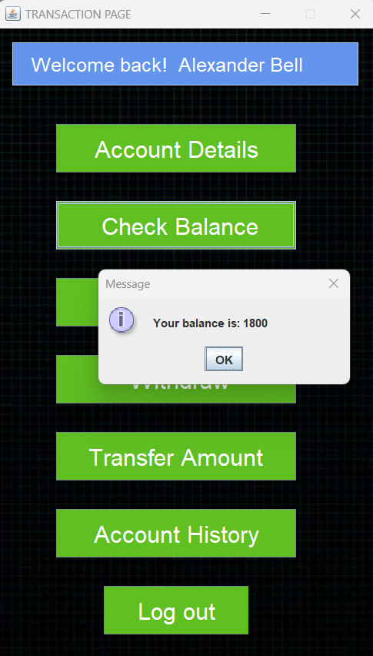
Check Balance: The user can check its account balance.

Slide 27
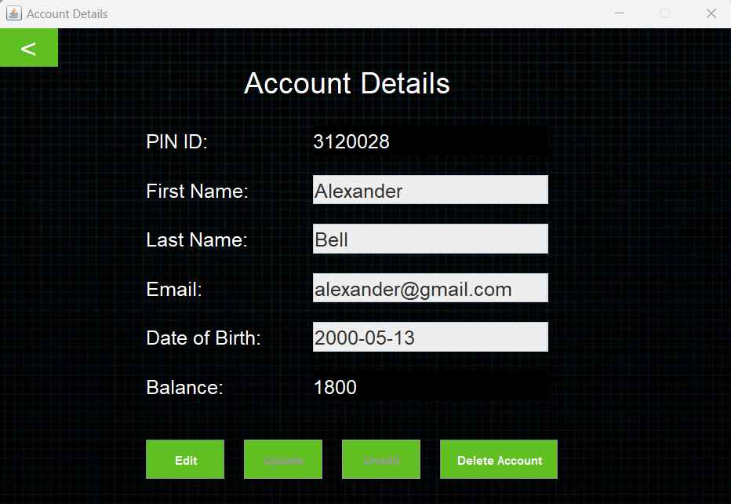
Account Details: Presents user account-related information.
User can edit the information or delete account.

Slide 28
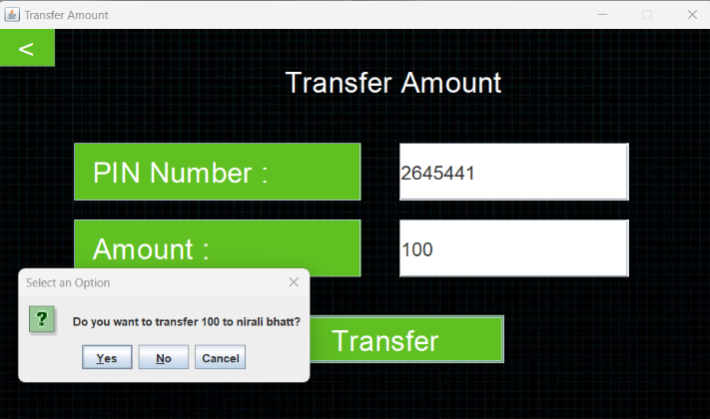
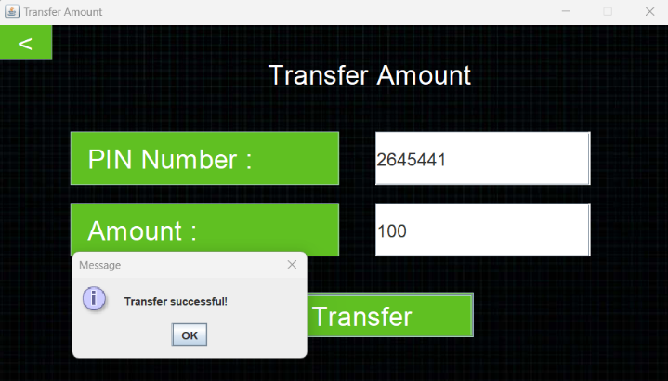
Transfer Amount: User can transfer amount to another user using same application.
User just need to add the Pin of another user who he/she wants to send and the amount.

Slide 29
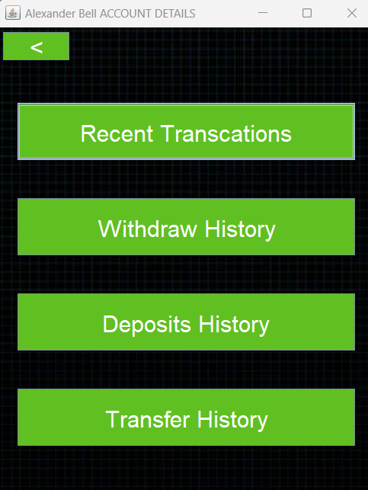
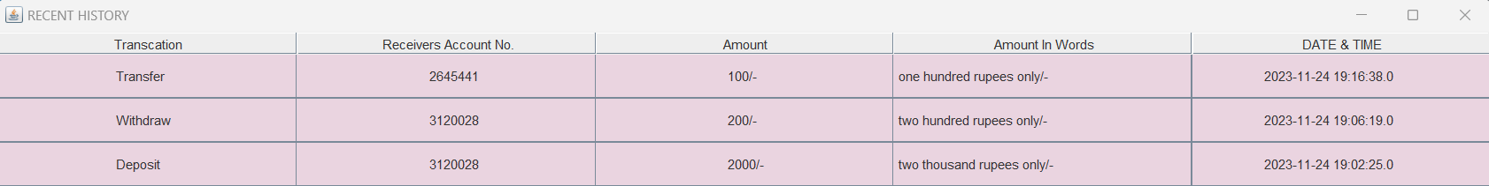
Account History: User can view its transaction history(Mini Statements).

Slide 30
TESTING
Black-box Testing
1. Unit Testing
3. System Testing
Methodologies used for Testing
Types of Testing Performed
2. Integration Testing
4. Regression Testing
White-box Testing

Slide 31
conclusion
In an era of advancing financial technologies, the CashCraft project emerges as a pioneering solution, aiming to redefine the landscape of digital financial transactions.
The project addresses the evolving needs of a rapidly changing society by introducing a revolutionary fintech application that performs bankless transaction.
CashCraft, titled "Mastering Your Financial Journey," stands at the forefront of innovation, offering a novel approach to monetary exchanges and accessibility in the financial domain.
CashCraft is driven by a vision to revolutionize the way individuals interact with and manage their finances.

Slide 32
FUTURE ENHANCEMENTS
Admin login with deposit and withdrawal on physical centers of fintech organization.
Security Measures.
Expanded Deposit Options.
Financial Services Expansion.
Email notification and verification.
Mobile notification and verification.
User Education and Support.

Slide 33
REFERENCES
https://www.railmitra.com/blog/indian-railways-smart-card
https://www.javatpoint.com/banking-application-in-java
https://coderspacket.com/banking-management-system-using-java-swing-and-mysql
https://1000projects.org/online-banking-application-project.html
https://www.geeksforgeeks.org/mini-banking-application-in-java/
https://copyassignment.com/bank-management-system-project-in-java/
https://codezips.com/java/bank-management-system-in-java-with-source-code/

Slide 34
THANK YOU !!!

